Slide 1
Debugging without debugger Investigating SQL Server's internal structures
Hugo Kornelis
Database consultant

Slide 2

Hugo Kornelis
I make SQL Server Fast
I make SQLServerFast.com
Execution Plan Reference: https://sqlserverfast.com/epr
Detailed description of all operators, and other relevant information

Slide 3
Hugo Kornelis
I make SQLServerFast.com
Execution Plan Reference: https://sqlserverfast.com/epr
SQL Server Execution Plan Video training: https://sqlserverfast.com/video
In-depth training courses on execution plans
Limited time offer: 10% off with code “given during delivery” (expires dd-mm-yyyy)

Slide 4
Hugo Kornelis
I make SQLServerFast.com
Execution Plan Reference: https://sqlserverfast.com/epr
SQL Server Execution Plan Video training: https://sqlserverfast.com/video
Other content
Blog: https://sqlserverfast.com/blog
Articles: https://sqlserverfast.com/articles
Longer, even more detailed in-depth information
Resources
Deck and demo for this session (and others)
Go to sqlserverfast.com, then Other / Presentations / Presentation resources

Slide 5
Hugo Kornelis
I make SQLServerFast.com
I do other community things
I work (consulting, training)
Contact details
Email: hugo@perFact.info
Twitter: @Hugo_Kornelis

Slide 6
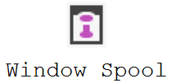
Debugging without debugger
Window Spool operator
Stores incoming rows in an internal “worktable”
Sends stored rows multiple times to its parent operator
All spools do this; Window Spool is specifically for windowing functions (OVER clause)
DEMO

Slide 7
Window Spool
Window Spool operator
Stores incoming rows in an internal “worktable”
Sends stored rows multiple times to its parent operator
So … how is this worktable stored exactly?
In memory if number of rows can never exceed 10,000
On disk otherwise
We’ll investigate the on disk version

Slide 8
Problems to overcome
Structures released when query finishes
Investigating can take a lot of time
Query duration is limited
Options?
Use debugger to halt the process
Unlimited access, even to internal memory structures
Much too complicated (for me)
Not possible to use SQL Server commands when SQL Server process is halted

Slide 9
Problems to overcome
Structures released when query finishes
Investigating can take a lot of time
Query duration is limited
Options?
Use debugger to halt the process
Create a VERY slow query
Might still take less time than needed
Storage locations not guaranteed the same upon restart

Slide 10
Problems to overcome
Structures released when query finishes
Investigating can take a lot of time
Query duration is limited
Options?
Use debugger to halt the process
Create a VERY slow query
Use locking and blocking to “freeze” a query
Can be held as long as needed
Fully supported
DEMO

Slide 11
Problems to overcome
Structures released when query finishes
Finding the object(s)
Lots of things don’t work
SELECT * FROM tempdb.dbo. … eeuhm, what’s the name of the object?
Object is not stored in sys.indexes, nor in the (deprecated) sys.sysindexes
Query before starting Window Spool query, then again after starting and freezing it
Compare results of the two queries
DEMO

Slide 12
Problems to overcome
Structures released when query finishes
Finding the object(s)
Lots of things don’t work
SELECT * FROM tempdb.dbo. … eeuhm, what’s the name of the object?
Object is not stored in sys.indexes, nor in the (deprecated) sys.sysindexes
Object is not stored is underlying system tables
Compare #rows in all operators of execution plan plus run-time stats on sys.[sys]indexes
For operators with residual predicate, compare actual data in the system table
Can only be read when connected on dedicated administrator connection
Or you can use DBCC PAGE for this (using sys.sysindexes to locate the pages)
DEMO

Slide 13
Problems to overcome
Structures released when query finishes
Finding the object(s)
Lots of things don’t work
But some things still do work
Look at changes in PFS page (page 1 in database file, lists page allocated or free)
Pick allocated page to find allocation unit
Query sys.dm_os_buffer_descriptors to find all pages (by type) of that object
Use DBCC PAGE on these pages to inspect contents
DEMO

Slide 14
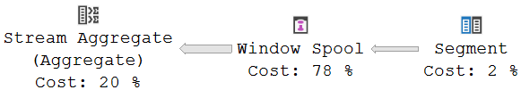
Problems to overcome
Structures released when query finishes
Finding the object(s)
Figuring out the structure
What do we expect?
Output List:
SalesOrderID
SalesOrderDetailID
CarrierTrackingNo
RowNumber1005
WindowCount1010
Segment1009
Output List:
SalesOrderID
SalesOrderDetailID
CarrierTrackingNo
RowNumber1005
TopRowNumber1006
BottomRowNumber1007
Segment1009

Slide 15
Problems to overcome
Structures released when query finishes
Finding the object(s)
Figuring out the structure
What do we expect?
How to read pages
Inside Microsoft SQL Server 2005: The Storage Engine (Kalen Delaney)

Slide 16
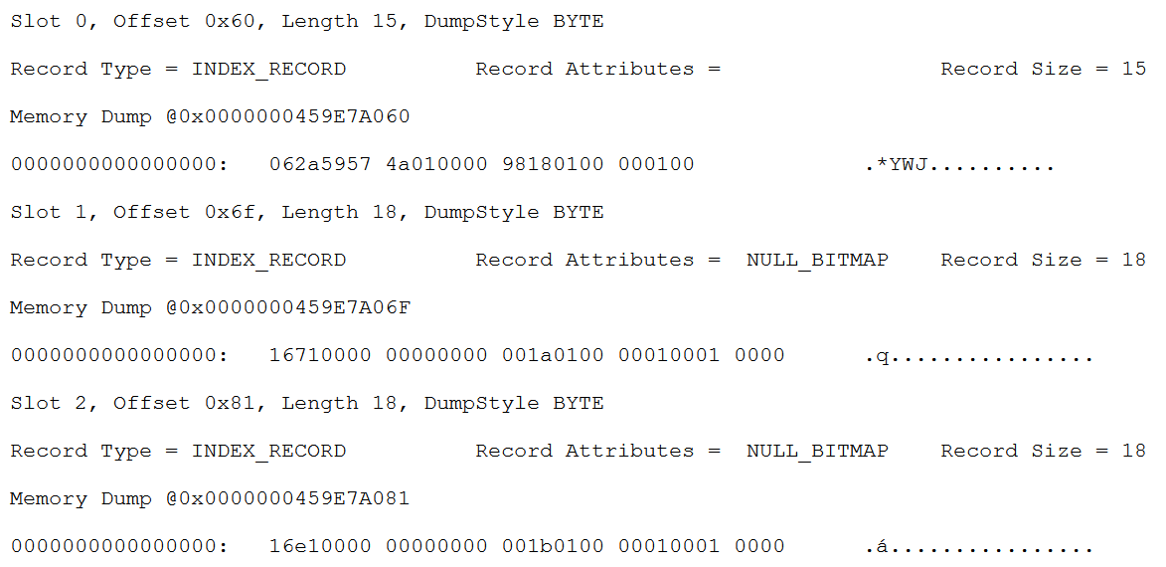
Figuring out the structure
Index rows
Index row 1
Status byte
06: index row, no NULL bitmap

Slide 17
Figuring out the structure
Index rows
Index row 1
Status byte
06: index row, no NULL bitmap
Down page pointer
00 01 → file #1

Slide 18
Figuring out the structure
Index rows
Index row 1
Status byte
06: index row, no NULL bitmap
Down page pointer
00 01 → file #1
00 00 01 18 → page 0x118 = 280

Slide 19
Figuring out the structure
Index rows
Index row 1
Status byte
06: index row, no NULL bitmap
Down page pointer
00 01 → file #1
00 00 01 18 → page 0x118 = 280
Index key
Meaningless content on 1st entry

Slide 20
Figuring out the structure
Index rows
Index row 1
Index row 2
Status byte
16: index row, with NULL bitmap

Slide 21
Figuring out the structure
Index rows
Index row 1
Index row 2
Status byte
16: index row, with NULL bitmap
Down page pointer
00 01 → file #1
00 00 01 1A → page 0x11A = 282

Slide 22
Figuring out the structure
Index rows
Index row 1
Index row 2
Status byte
16: index row, with NULL bitmap
Down page pointer
00 01 → file #1
00 00 01 1A → page 0x11A = 282
Index key
00 00 00 00 00 00 00 71 = 0x71 = 113

Slide 23
Figuring out the structure
Index rows
Index row 1
Index row 2
Status byte
16: index row, with NULL bitmap
Down page pointer
00 01 → file #1
00 00 01 1A → page 0x11A = 282
Index key
00 00 00 00 00 00 00 71 = 0x71 = 113
Number of columns
00 01 = 1 column

Slide 24
Figuring out the structure
Index rows
Index row 1
Index row 2
Status byte
16: index row, with NULL bitmap
Down page pointer
00 01 → file #1
00 00 01 1A → page 0x11A = 282
Index key
00 00 00 00 00 00 00 71 = 0x71 = 113
Number of columns
00 01 = 1 column
Null bitmap
No null values in this case

Slide 25
Figuring out the structure
Index rows
Index row 1
Index row 2
Index row 3
Status byte
16: index row, with NULL bitmap
Down page pointer
00 01 → file #1
00 00 01 1B → page 0x11B = 283
Index key
00 00 00 00 00 00 00 E1 = 0xE1 = 225
Number of columns
00 01 = 1 column
Null bitmap
No null values in this case

Slide 26
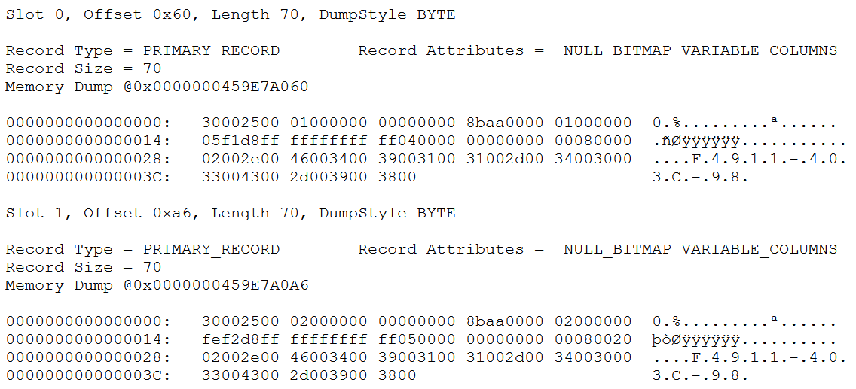
Figuring out the structure
Data rows
Data row 1
Status bytes
30 00: data row, NULL bitmap, var. len

Slide 27
Figuring out the structure
Data rows
Data row 1
Status bytes
End of fixed data
00 25 = position of # columns

Slide 28
Figuring out the structure
Data rows
Data row 1
Status bytes
End of fixed data
Number of columns
00 08 = eight columns total

Slide 29
Figuring out the structure
Data rows
Data row 1
Status bytes
End of fixed data
Number of columns
NULL bitmap
(Single byte for up to 8 columns)

Slide 30
Figuring out the structure
Data rows
Data row 1
Status bytes
End of fixed data
Number of columns
NULL bitmap
Number of variable length cols
00 02 = two variable length columns

Slide 31
Figuring out the structure
Data rows
Data row 1
Status bytes
End of fixed data
Number of columns
NULL bitmap
Number of variable length cols
Column offsets
1st var. column ends before 0x2E
2nd var. column ends before 0x46

Slide 32
Figuring out the structure
Data rows
Data row 1
Status bytes
End of fixed data
Number of columns
NULL bitmap
Number of variable length cols
Column offsets
1st var. column ends before 0x2E
2nd var. column ends before 0x46
Variable data
1st var. column – zero length: ???
2nd var. column: carrier tracking nbr.

Slide 33
Figuring out the structure
Data rows
Data row 1
Variable length data
1st var. column – zero length: ???
2nd var. column: Carrier tracking nbr.
Fixed length data
1st fixed: bigint – RowNumber

Slide 34
Figuring out the structure
Data rows
Data row 1
Variable length data
1st var. column – zero length: ???
2nd var. column: Carrier tracking nbr.
Fixed length data
1st fixed: bigint – RowNumber
2nd fixed: int – SalesOrderID
0xAA8B = 43659

Slide 35
Figuring out the structure
Data rows
Data row 1
Variable length data
1st var. column – zero length: ???
2nd var. column: Carrier tracking nbr.
Fixed length data
1st fixed: bigint – RowNumber
2nd fixed: int – SalesOrderID
3rd fixed: int – SalesOrderDetailID

Slide 36
Figuring out the structure
Data rows
Data row 1
Variable length data
1st var. column – zero length: ???
2nd var. column: Carrier tracking nbr.
Fixed length data
1st fixed: bigint – RowNumber
2nd fixed: int – SalesOrderID
3rd fixed: int – SalesOrderDetailID
6th fixed: bigint – BottomRowNumber

Slide 37
Figuring out the structure
Data rows
Data row 1
Variable length data
1st var. column – zero length: ???
2nd var. column: Carrier tracking nbr.
Fixed length data
1st fixed: bigint – RowNumber
2nd fixed: int – SalesOrderID
3rd fixed: int – SalesOrderDetailID
5th fixed: bigint – TopRowNumber
6th fixed: bigint – BottomRowNumber
0xFFFFFFFFFFFFFD8F1 = -9999

Slide 38
Figuring out the structure
Data rows
Data row 1
Variable length data
1st var. column – zero length: ???
2nd var. column: Carrier tracking nbr.
Fixed length data
1st fixed: bigint – RowNumber
2nd fixed: int – SalesOrderID
3rd fixed: int – SalesOrderDetailID
4th fixed – single byte: ????
5th fixed: bigint – TopRowNumber
6th fixed: bigint – BottomRowNumber

Slide 39
Figuring out the structure
Data rows
That mysterious single-byte column….
Sometimes different between subsequent tries
Always an odd number on the first row in the worktable
Always an even number on all other rows
Theory:
Data row 1
Variable length data
1st var. column – zero length: ???
2nd var. column: Carrier tracking nbr.
Fixed length data
1st fixed: bigint – RowNumber
2nd fixed: int – SalesOrderID
3rd fixed: int – SalesOrderDetailID
4th fixed – single byte: ????
5th fixed: bigint – TopRowNumber
6th fixed: bigint – BottomRowNumber

Slide 40
Figuring out the structure
Data rows
That mysterious single-byte column….
Sometimes different between subsequent tries
Always an odd number on the first row in the worktable
Always an even number on all other rows
Theory:
Seven bits unused
Eighth bit is Segment1009
Data row 1
Variable length data
1st var. column – zero length: ???
2nd var. column: Carrier tracking nbr.
Fixed length data
1st fixed: bigint – RowNumber
2nd fixed: int – SalesOrderID
3rd fixed: int – SalesOrderDetailID
4th fixed: byte – Segment1009 (1 bit)
5th fixed: bigint – TopRowNumber
6th fixed: bigint – BottomRowNumber

Slide 41
Figuring out the structure
Data rows
That mysterious single-byte column….
But what about that zero length column?
Seems to be zero length on ALL rows, always
My theory (based on similarity with other spools):
Uniquifier column
Data row 1
Variable length data
1st var. column – zero length: ???
2nd var. column: Carrier tracking nbr.
Fixed length data
1st fixed: bigint – RowNumber
2nd fixed: int – SalesOrderID
3rd fixed: int – SalesOrderDetailID
4th fixed: byte – Segment1009 (1 bit)
5th fixed: bigint – TopRowNumber
6th fixed: bigint – BottomRowNumber

Slide 42
Figuring out the structure
Data rows
That mysterious single-byte column….
But what about that zero length column?
Seems to be zero length on ALL rows, always
My theory (based on similarity with other spools):
Uniquifier column
Used in non-unique clustered indexes
First row for any key value: empty (no data)
Extra rows with same key values: 4-byte ascending integer
Data row 1
Variable length data
1st var. column: Uniquifier (always empty)
2nd var. column: Carrier tracking nbr.
Fixed length data
1st fixed: bigint – RowNumber
2nd fixed: int – SalesOrderID
3rd fixed: int – SalesOrderDetailID
4th fixed: byte – Segment1009 (1 bit)
5th fixed: bigint – TopRowNumber
6th fixed: bigint – BottomRowNumber

Slide 43
Problems to overcome
Structures released when query finishes
Finding the object(s)
Figuring out the structure
Reading and interpreting the data
Worktable of Windows Spool uses a clustered index
Indexed on row number column from input, declared as nonunique
All input columns are stored in the worktable

Slide 44
T H E E N D
Questions?
Email: hugo@perFact.info
Twitter: @Hugo_Kornelis

Slide 45
T H E E N D
Questions?
Email: hugo@perFact.info
Twitter: @Hugo_Kornelis

